Slide 1

Embedded HVAC Controller
Mini Project

Slide 2
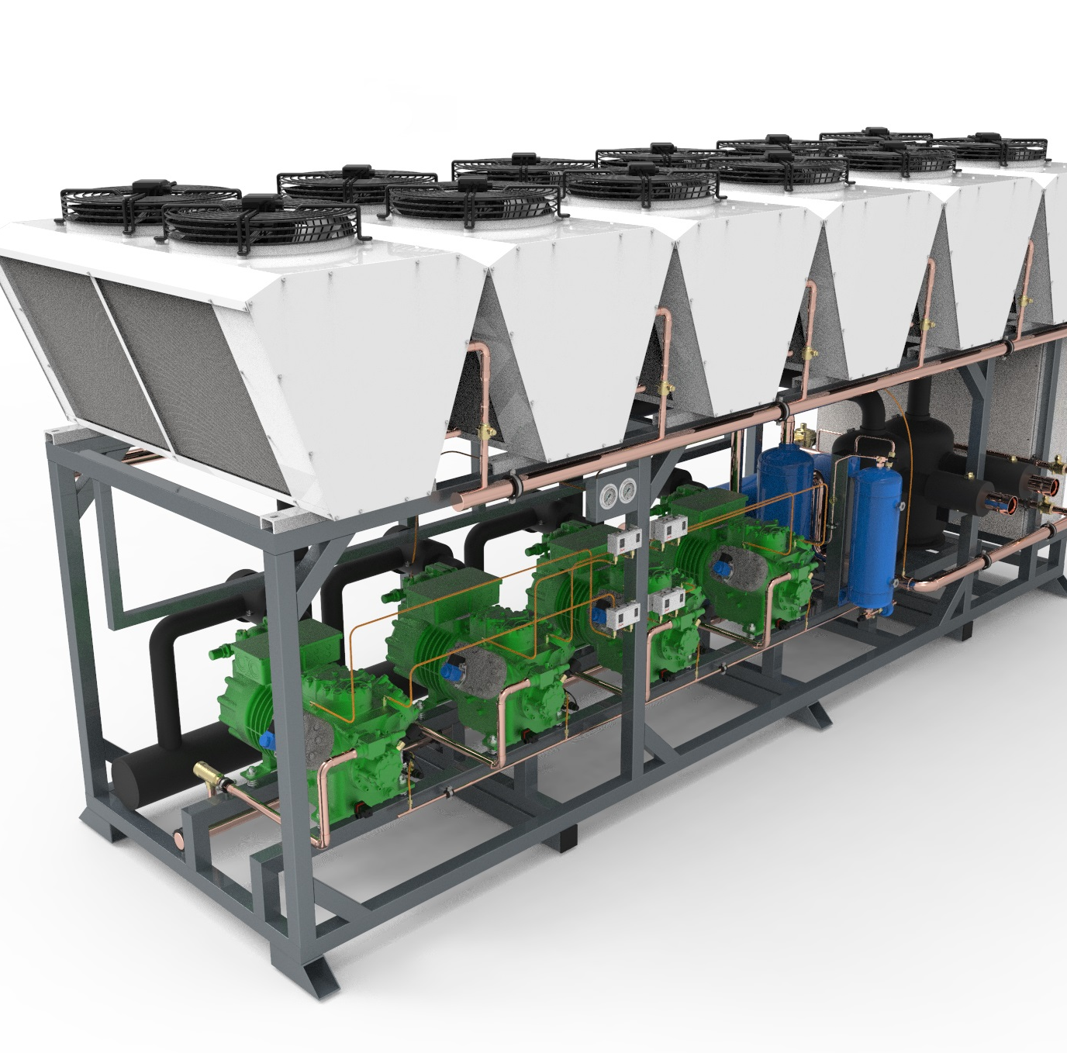
Project Overview
The project comprises a microcontroller-based control system and a Human-Machine Interface (HMI) that work together to regulate the temperature of a premises by controlling a rooftop HVAC unit equipped with two compressors. The system operates by utilizing both compressors at the beginning to quickly cool down the room to the desired temperature. Afterward, the microcontroller automatically switches between the compressors every 30 minutes, providing rest to each compressor in turn. This approach ensures the longevity of the expensive compressor components while maintaining the desired temperature in the premises.

Slide 3
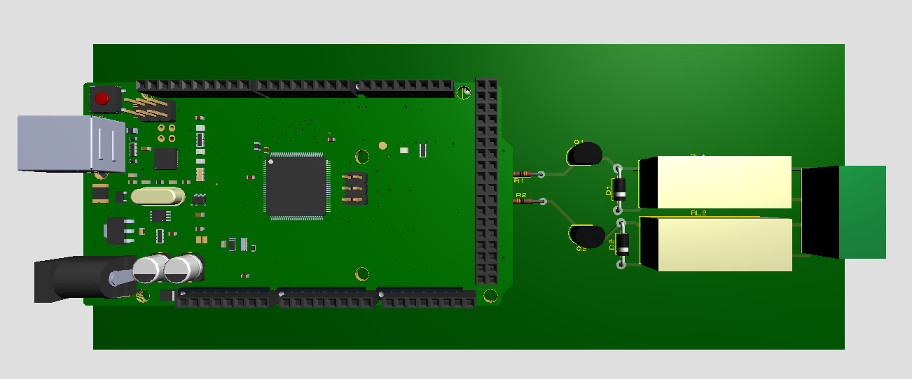
Hardware Overview
Components:
Mcu: Atmega 2560p
Resistor: 330Ω
Diode: 1n4007
Relay: SPNO
Terminal Block

Slide 4
Software Overview
Architecture:
The software architecture of the project follows a simple yet effective approach, where the code on the microcontroller is designed to implement multiple tasks using a RTOS, while the HMI is used to provide a user-friendly interface for controlling the system and monitoring the temperature. The two components communicate through a serial port, allowing for real-time data transfer between the microcontroller and the HMI. The app and mcu communicate using hardware serial, however, there is a flow control mechanism implemented to ensure the app send mcu commands based on send-acknowledge procedure so that not a single command is missed by the board.

Slide 5

Microcontroller Code
RTOS Tasks:
Simulation Task: Models the thermal energy transfer of the room based on wall thermal resistance, room volume, room heat capacity, outside temperature and inside temperature
Print Task: This task receives messages from other processes that needs to be sent to serial port. It keeps on reading through a queue which is filled by other tasks.
Receive Task: This task receives messages from serial port and parses the command messages. After successful parse, it will send acknowledgement to app
Compressor Task: This task depending on the state will either turn on both compressors or select only one if temperature is above set point based on information from Load Balancer Task
Load Balancer Task: Its job is to select one compressor every set period so that only one compressor is active.

Slide 6
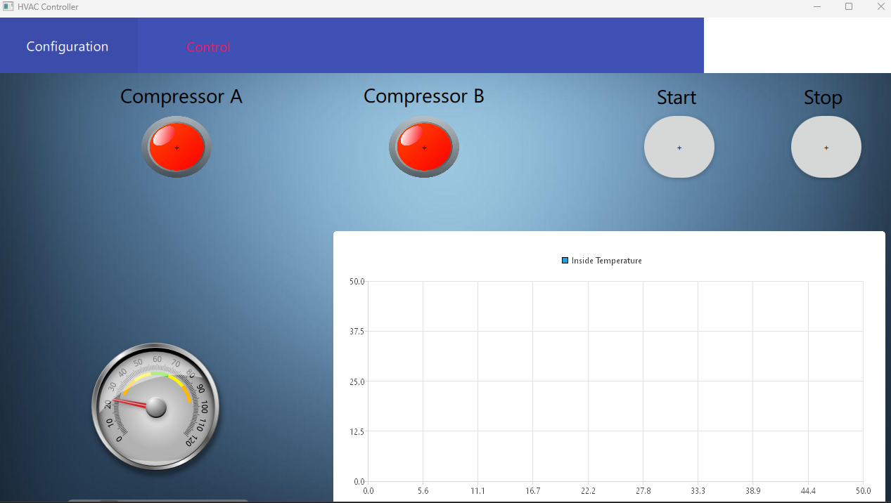
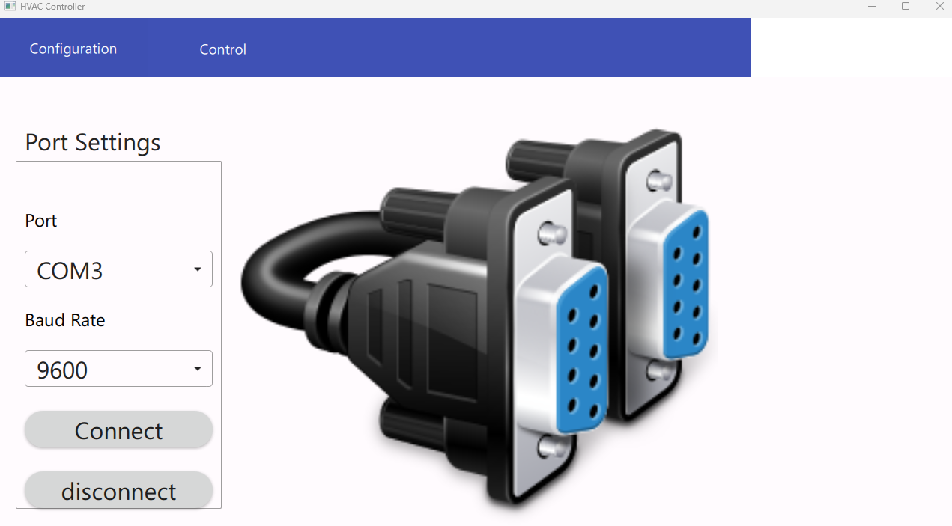
HMI
Controls the MCU and collects temperature data and component status

Slide 7
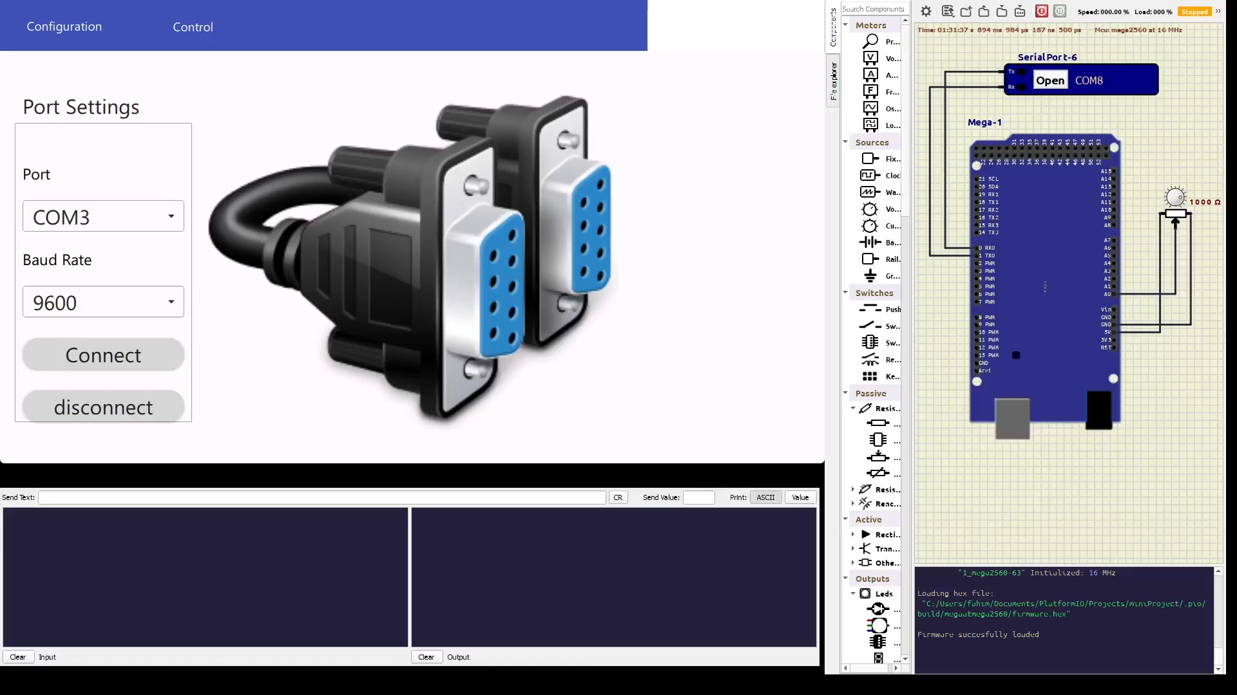
Demo

